Slide 1
Video game development using unity (FPS)
A mini project by Aman Abdul Malik K P
MES20MCA-2004
Product Owner : Mr. Hyder Ali K

Slide 2
TABLE OF CONTENTS
Project Description | 3
Modules | 4
Developing Environment | 10
Product Backlog | 12
User Story | 14
Project Plan | 16
Sprint Backlog Plan | 19
Sprint Backlog Actual | 24

Slide 3
Captain G
Captain G is a 3D First-Person Shooter(FPS) game developed with Unity Engine. First-person shooter (FPS) is a sub-genre of shooter video games centered on guns and other weapon-based combat in a first-person perspective, with the player experiencing the action through the eyes of the protagonist and controlling the player character in a three-dimensional space. The genre shares common traits with other shooter games. Shooter video games or shooters are a sub-genre of action video games where the focus is almost entirely on the defeat of the character's enemies using the weapons given to the player.

Slide 4
Modules

Slide 5
Module 1: Prototype
A sample scene with templates describing the main theme or story of the game.
The scene will contain:
Main character (Hero) and weapons
World or terrain
Enemies
Other game objects

Slide 6
Module 2: Design
3 different tracks *
Time attack
Circuit
Terrain and World Design
Character design and customizations
Weapon design and modifications
Level design

Slide 7
Module 3: game mechanics
Player movement and actions
Game physics
Key bindings and game controls

Slide 8
Module 4: game Ai tracks and cars will be added
Different difficulty levels
Easy
Medium
Hard
Enemy behavior
Combat AI
Player recognition
Hunting
Different difficulty levels:
Easy
Medium
Hard

Slide 9
Module 5: UI
Various user interfaces for
Game Launch Screen
Main Menu
Pause Menu
Mini Map
Speedometer
Time
Lap
User interfaces for
Game Launch Screen
Main Menu
Pause Menu
Mini Map
Player Health
Point count
Ammo count
Timer
Weapon Selection

Slide 10

Developing Environment

Slide 11
Hardware Requirements
Processor - Intel Core i5 (min)
Speed - 1.5 GHz (min)
RAM - 4 GB (min)
Hard Disk - 50 GB or (min)
GPU - 1 GB (min)
Software Requirements
Operating System - Windows 10
Game Engine - Unity
Programming Language - C#
SFX - Audacity
Modeling - Blender (if necessary)
Texturing - Photoshop (if necessary)

Slide 12
Product backlog

Slide 13
User story ID | Priority <High / Medium / Low> | Size (Hours) | Sprint <#> | Status <Planned / In progress / Completed> | Release Date | Release Goal
1 | High | 6 | 1 | Completed |  | Creation of player in first person perspective
2 | High | 6 |  | In progress |  | Creation of enemy characters
3 | High | 4 |  | Completed |  | Maps(Terrain, World)
4 | High | 6 | 2 | Planned |  | World / Terrain design
5 | High | 2 |  | Planned |  | Main mode (Scripting, UI)
6 | Low | 2 |  | Planned |  | Time attack (Scripting, UI)
7 | High | 10 | 3 | Planned |  | AI and Selectable weapons (Coding)
8 | High | 2 | 4 | Planned |  | Difficulty levels
9 | Low | 2 |  | Planned |  | Key Binding
10 | High | 10 |  | Planned |  | Final UI

Slide 14
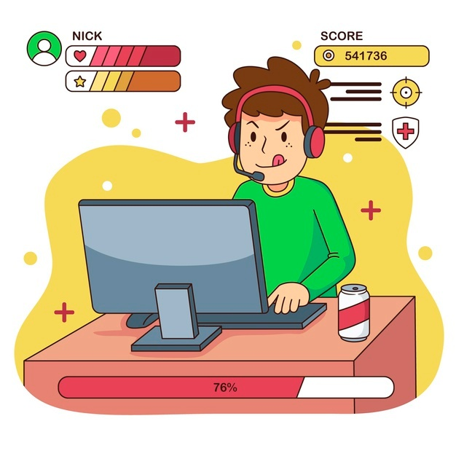
User stories

Slide 15
User Story ID | As a type of User | I want to <perform some task> | So that I can < Achieve Some Goal>
1 | Player | Control the main character | Move and interact in the game world
2 | Player | See the enemies | Destroy the enemies
3 | Player | See the map | Know what to expect
4 | Player | See the world and terrain | Know where to go next
5 | Player | See the UI for main mode | Play the main mode
6 | Player | See the UI for time attack mode | Play the time attack mode
7 | Player | See type of enemies and see different weapons | Use different weapons on different enemies
8 | Player | Select difficulty levels | Make the gameplay more challenging
9 | Player | View key bindings | Know the gaming controls
10 | Player | See final UI

Slide 16

project plan

Slide 17
User Story ID | Task Name | Start Date | End Date | Days | Status
SPRINT 1
1 | Player Character | 30/11/2021 | 10/12/2021 | 10 | Completed
2 | Maps(world, terrain) | 15/12/2021 | 19/12/2021 | 4 | Completed
SPRINT 2
3 | Creation of enemy characters | 15/01/2022 | 25/01/22 | 10 | In progress
4 | World / Terrain design | 26/01/22 | 27/01/22 | 2 | In progress
5 | Main mode (Scripting, UI) | 29/01/22 | 31/01/2022 | 2 | In progress

Slide 18
User Story ID | Task Name | Start Date | End Date | Days | Status
SPRINT 3
6 | Time attack (Scripting, UI) | 03/02/2022 | 12/02/2022 | 10 | Planned
7 | AI and Selectable weapons (Coding) | 17/02/2022 | 20/02/2022 | 3 | Planned
SPRINT 4
8 | Difficulty Levels | 21/02/2022 | 23/02/2022 | 3 | Planned
9 | Key Binding | 24/03/2022 | 26/02/2022 | 3 | Planned
10 | Final UI | 26/03/2022 | 02/03/2022 | 8 | In progress

Slide 19
Sprint backlog

Slide 20
Backlog Item | Status & completion date | Original estimate in hours | Day1 | Day2 | Day3 | Day4 | Day5 | Day6 | Day7 | Day8 | Day9 | Day10 | Day11 | Day12 | Day13 | Day14
User story #1 |  | hrs | hrs | hrs | hrs | hrs | hrs | hrs | hrs | hrs | hrs | hrs | hrs | hrs | hrs | hrs
Modelling (Player) | Completed | 4 | 1 | 1 | 0 | 1 | 1 | 0 | 0 | 0 | 0 | 0 | 0 | 0 | 0 | 0
Script | Completed | 2 | 0 | 0 | 0 | 0 | 0 | 1 | 0 | 1 |  |  | 0 | 0 | 0 | 0
Testing | In progress | Continuous | Yes
User story #2
Modelling (Enemies) | In progress | 4 | 0 |  | 0 | 0 | 2 | 0 | 0 | 0 | 0 | 0 | 1 | 1 | 0 | 0
Script | In progress | 2 | 0 | 0 | 0 | 0 | 0 | 1 | 0 | 0 | 0 | 0 | 1 | 0 | 0 | 0

Slide 21
Backlog Item | Status & completion date | Original estimate in hours | Day1 | Day2 | Day3 | Day4 | Day5 | Day6 | Day7 | Day8 | Day9 | Day10 | Day11 | Day12 | Day13 | Day14
User story #3 Design (maps) | Planned | 4 | 1 | 1 | 1 | 1 |  | 0 | 0 | 0 | 0 | 0 | 0 | 0 | 0 | 0
User story #4 Design (World, terrain) | Planned | 6 | 1 | 1 | 1 | 0 | 0 | 0 | 1 | 1 | 1 | 0 | 0 | 0 | 0 | 0
User story #5
(UI, Scripting) | Planned | 2 | 0 | 0 | 0 | 0 | 0 | 0 | 0 | 0 | 1 | 1 | 0 | 0 | 0 | 0
Testing | Planned | Continuous

Slide 22
Backlog Item | Status & completion date | Original estimate in hours | Day1 | Day2 | Day3 | Day4 | Day5 | Day6 | Day7 | Day8 | Day9 | Day10 | Day11 | Day12 | Day13 | Day14
User story #6 |  | hrs | hrs | hrs | hrs | hrs | hrs | hrs | hrs | hrs | hrs | hrs | hrs | hrs | hrs | hrs
Script | Planned | 2 | 0 | 0 | 0 | 0 | 0 | 1 | 0 | 1 |  |  | 0 | 0 | 0 | 0
Testing | Planned | Continuous | Yes
User story #7
Scripting(AI) | Planned | 10 | 2 | 0 | 2 | 0 | 1 | 1 | 1 | 0 | 2 | 0 | 0 | 0 | 1

Slide 23
Backlog Item | Status & completion date | Original estimate in hours | Day1 | Day2 | Day3 | Day4 | Day5 | Day6 | Day7 | Day8 | Day9 | Day10 | Day11 | Day12 | Day13 | Day14
User story #8 |  | hrs | hrs | hrs | hrs | hrs | hrs | hrs | hrs | hrs | hrs | hrs | hrs | hrs | hrs | hrs
Script(difficulty level) | Planned | 2 | 1 | 1 | 0 | 0 | 0 | 0 | 0 | 0 | 0 | 0 | 0 | 0 | 0 | 0
User story #9 (Key binding) | Planned | 2 | 0 | 0 | 1 | 1 | 0 | 0 | 0 | 0 | 0 | 0 | 0 | 0 | 0 | 0
Testing | Planned | Continuous | Yes
User story #10
Scripting | Planned | 3 | 0 | 0 | 0 | 0 | 1 | 0 | 0 | 1 | 0 | 0 | 1 | 0 | 0 | 0
Designing | Planned | 5 | 0 |  |  |  |  | 1 | 1 |  | 1 | 1 |  | 1 | 0 | 0
Final Test | Planned | 2 | 0 | 0 | 0 | 0 | 0 | 0 | 0 | 0 | 0 | 0 | 0 | 1 | 1

Slide 24
Sprint 1 Actual

Slide 25
Backlog Item | Status & completion date | Original estimate in hours | Day1 | Day2 | Day3 | Day4 | Day5 | Day6 | Day7 | Day8 | Day9 | Day10 | Day11 | Day12 | Day13 | Day14
User story #1 |  | hrs | hrs | hrs | hrs | hrs | hrs | hrs | hrs | hrs | hrs | hrs | hrs | hrs | hrs | hrs
Modelling (player) | Completed | 5 | 1 | 1 | 1 | 2 | 0
Script | Completed | 5 |  |  |  |  |  | 1 | 0 | 1 | 1 | 2 | 0 | 0 | 0 | 0
Testing | In progress | Continuous | Yes
User story #2
Modelling (Track) | Completed | 2 |  |  |  |  |  |  |  |  |  |  | 1 | 1
Modelling (Terrain) | Completed | 2 |  |  |  |  |  |  |  |  |  |  |  |  | 0 | 2

Slide 26
Thank you!

